Slide 1
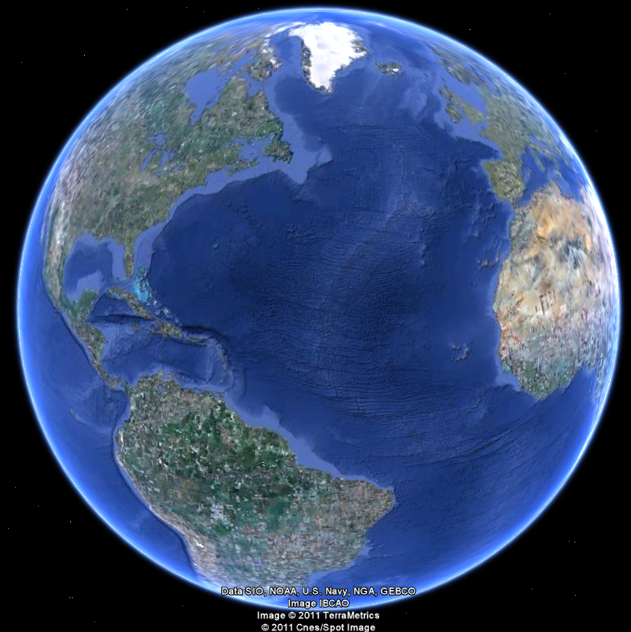
APEC 100 Sustainable Development
Where Do We Go From Here?

Slide 2
Opportunities To Stay Connected in the Future
Become a Teaching Assistant for APEC100 and earn credit for the “Advanced Sustainable Development” independent study class.
Do research internships with the Center for Experimental & Applied Economics.
Start as a volunteer
Become one of the paid student interns working on research
Apply for a Master’s or PhD in UD’s Department of Applied Economics & Statistics. Successful applicants can earn:
Complete Tuition Waiver
Living Expense Stipend
Value of ~$44,000 per year.

Slide 3
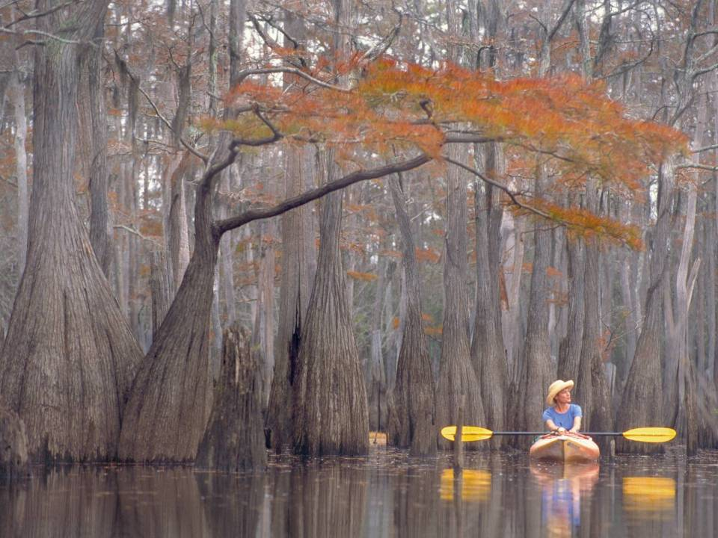
Where Do We Go From Here?

Slide 4
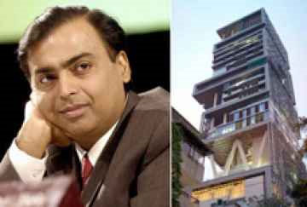
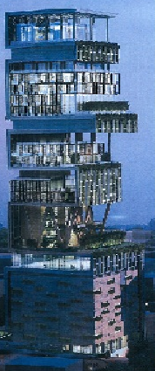
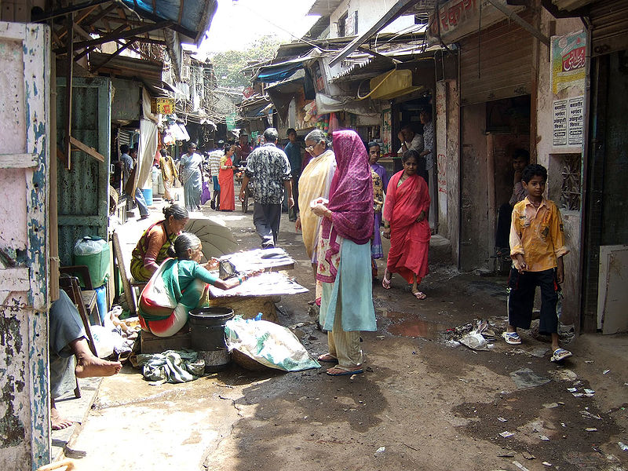
A World of Paradox
Mukesh Ambani’s home
Dharavi, India

Slide 5

Largest 20 Cities in the World
1. Tokyo, Japan - 28,025,000 2. Mexico City, Mexico - 18,131,000 3. Mumbai, India - 18,042,000 4. Sáo Paulo, Brazil - 17,711,000 5. New York City, USA - 16,626,000 6. Shanghai, China - 14,173,000 7. Lagos, Nigeria - 13,488,000 8. Los Angeles, USA - 13,129,000 9. Calcutta, India - 12,900,000 10. Buenos Aires, Argentina - 12,431,000
11. Seóul, South Korea - 12,215,000 12. Beijing, China - 12,033,000 13. Karachi, Pakistan - 11,774,000 14. Delhi, India - 11,680,000 15. Dhaka, Bangladesh- 10,979,000 16. Manila, Philippines - 10,818,000 17. Cairo, Egypt - 10,772,000 18. Õsaka, Japan - 10,609,000 19. Rio de Janeiro, Brazil- 10,556,000 20. Tianjin, China - 10,239,000
If the World was a
Village of 100 People

Slide 6
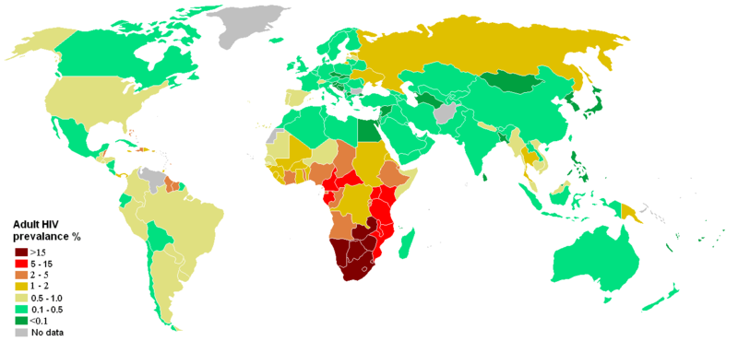
HIV Prevalence and Stigma

Slide 7

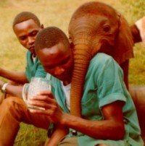
Humanistic and Naturalist Ethics

Slide 9
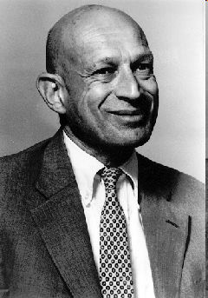
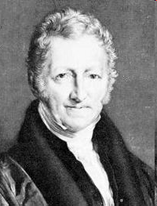
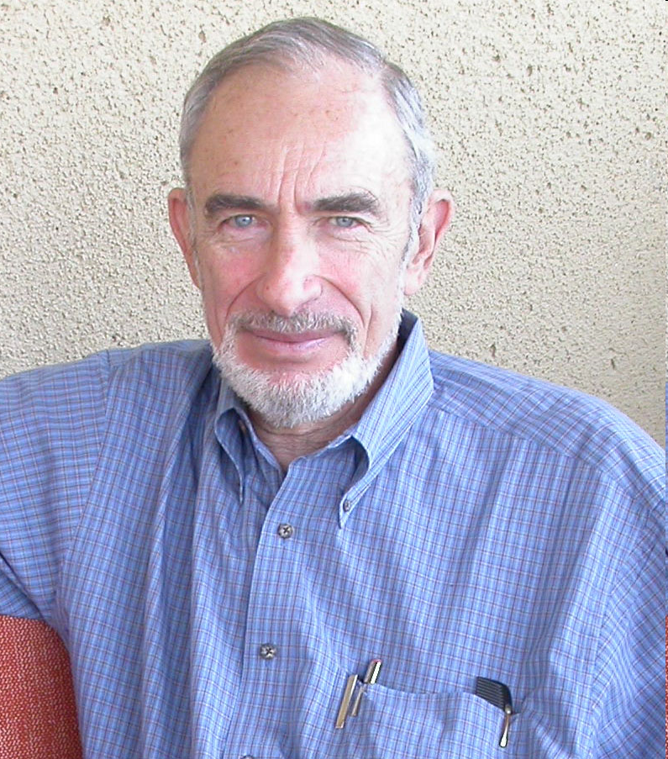
Will We Exhaust the Earth’s Resources?

Slide 10
 | RIVAL | NON-RIVAL
EXCLUDABLE | Private Goods Strawberries Blue Jeans | Club Goods Exercise Gym Pay-per-view TV
NON-EXCLUDABLE | Common Pool Resources Fish in the ocean Roads in rush hour Pollution in a lake | Public Goods Lab Experiment Clean Air Street Signs

Slide 11
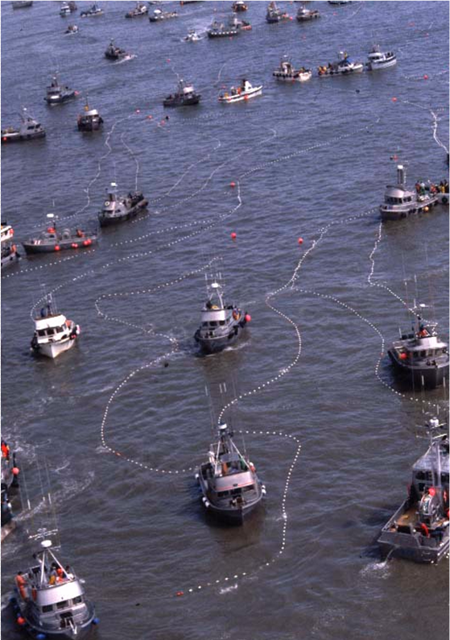
Negative Externalities: What to Do?
Compensate those harmed directly
Property rights assumption (Coase Theorem)
Lawsuits
Pollution Standards (Command-and-Control)
Tax Pollution
Examples (Solid waste pay-per-throw policy, turtle harvest tax, water pollution taxes, development impact fees)
Finding appropriate tax rates
Marketable Permits

Slide 12
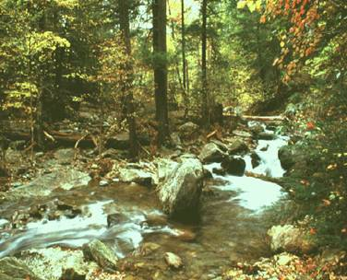
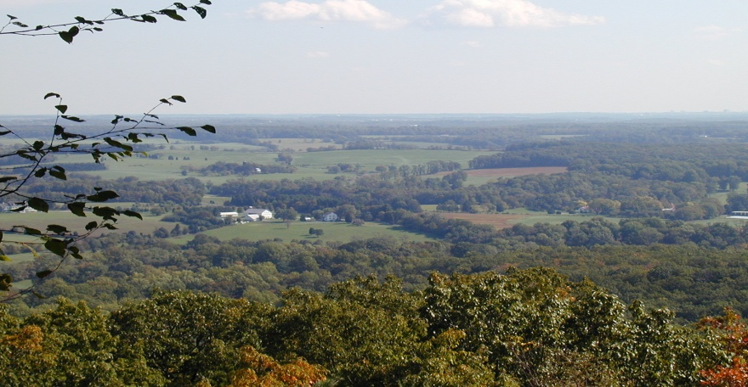
Economic Benefits of Protecting Natural Systems and Green Infrastructure
Economics as a humanistic philosophical perspective
“Use Value”
Ecosystem Services
Wetlands & water filtration
Trees, forests, and air cleaning
Working lands
Tourism
Recreation
Real estate
“Future Use Value”
Option to use later
“Non-use Value”
Existence and intrinsic values

Slide 13
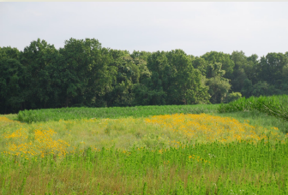

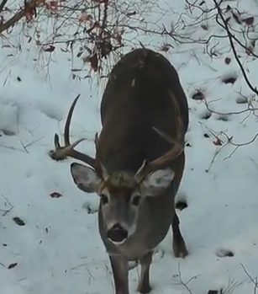
Preserving Nature: Delaware Wild Lands

Slide 14

Strategic Conservation in Pangaea

Slide 15
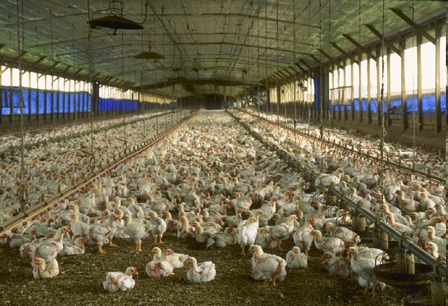

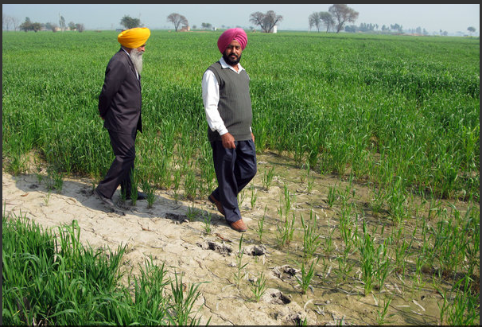
The Successes and Challenges of the Green Revolution The challenge of process labeling

Slide 16
Nine Factors to Improve Human Welfare
National unity (lack of internal conflict)
Market-oriented economy
Democratic form of government
Sound education system
Protection of private property rights
Opportunity for social and economic mobility
Level of economic growth exceeds the level of population growth
Corruption is relative minor.
Prevention of worse impacts of severe natural disasters

Slide 17
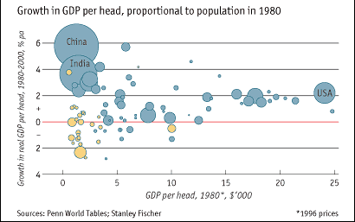
Source: “Catching up” The Economist Magazine, Aug 21st 2003

Slide 18
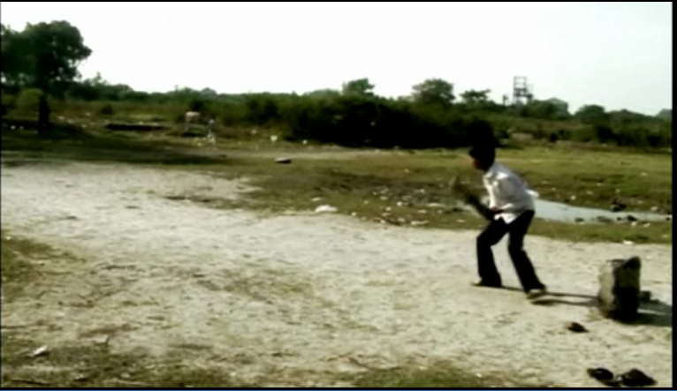


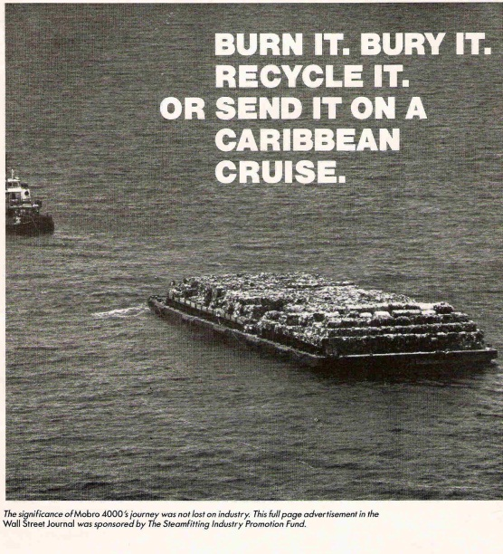
Behavioral Response to Risk

Slide 19

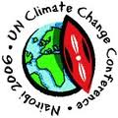



The Challenges of Climate Change

